Slide 1
Program Analysis and Verification

Slide 2
Program Analysis and Verification
Shahak Deutsch
30/09/23
https://github.com/shahak2/program-analysis-and-verification

Slide 3
Program Analysis and Verification
This is the final project for the course.
It contains the static analysis implementation for:
Parity Domain.
Summation (Interval) Domain.
Combined Domain.
It relies on concepts and algorithms proven in class. The analysis general flow is as follows:
The input: A path to a program as text file, a selected domain.
The program performs static analysis by:
Generating a control flow graph (CFG).
Performing Chaotic Iterations until it reaches a fixed point. In each iteration, a transformer updates the state of the node.

Slide 4
Program Analysis and Verification
Termination
We rely on the Fixed-Point Theorem [Kleene]. Our lattices are POSETs satisfying the ascending chain condition (ACC). Our transformers, aka functions, are monotonic. Thus, they are continuous. Thus, the Chaotic Iteration algorithm always terminates.
Soundness
Our abstract interpretations are locally sound. Resulting in global correctness.

Slide 5
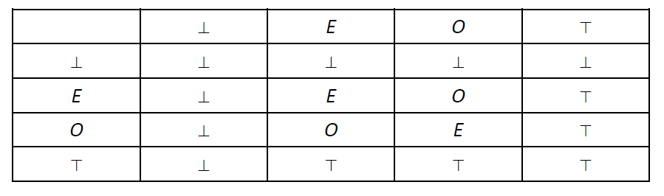
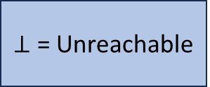
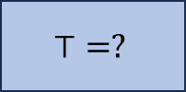
Parity Analysis
The Parity Domain
Transformers
$$⊤=?$$
Using tables to represent the relations between operations on domain elements. For example, addition of two elements in the domain:
Even
Odd
$⊥$ = Unreachable

Slide 6
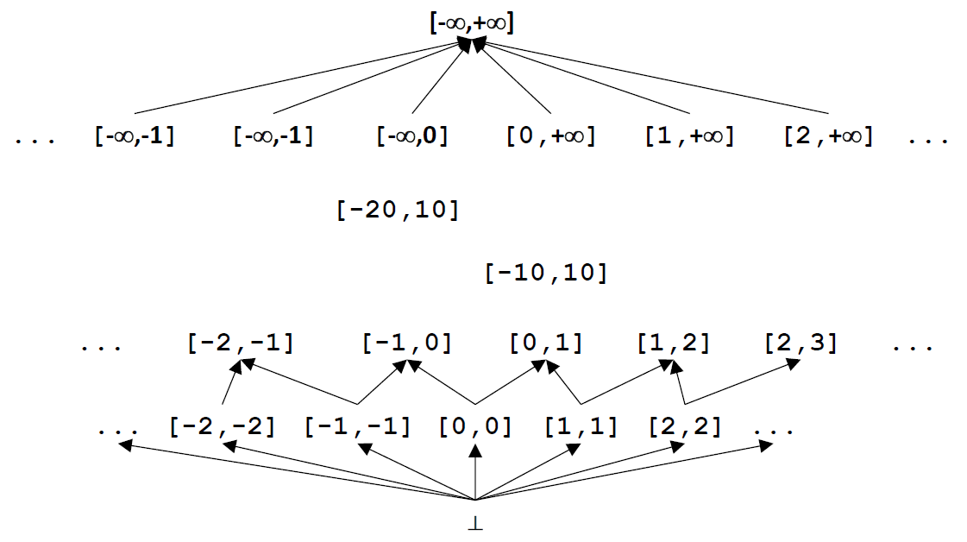
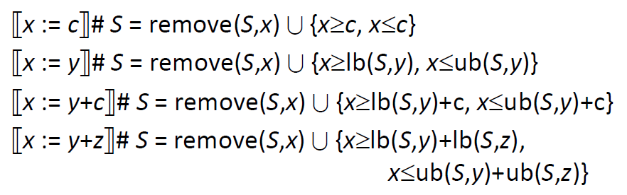
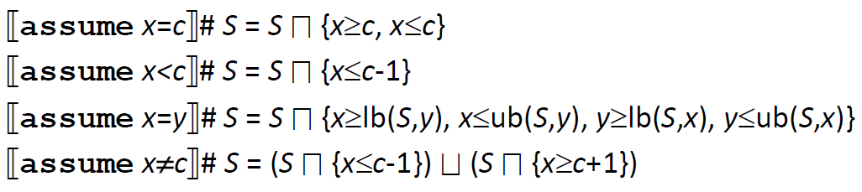
Summation Analysis
The Interval Domain
Transformers

Slide 7
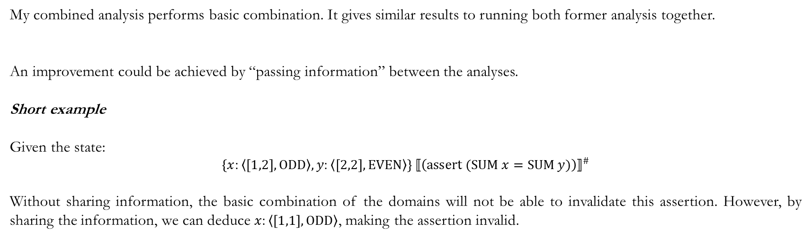
Combined Analysis
My combined analysis performs basic combination. It gives similar results to running both former analysis together.
An improvement could be achieved by “passing information” between the analyses.
Short example
Given the state:
$$\left\{x:\left\langle \left[1,2\right],\text{ODD}\right\rangle , y:\left\langle \left[2,2\right],\text{EVEN}\right\rangle \right\} {⟦\left(\text{assert} (\text{SUM} x=\text{SUM} y)\right)⟧}^{\#}$$
Without sharing information, the basic combination of the domains will not be able to invalidate this assertion. However, by sharing the information, we can deduce $x:\left\langle \left[1,1\right],\text{ODD}\right\rangle$, making the assertion invalid.

Slide 8
Test Programs

Slide 9
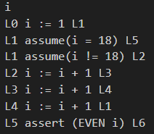
Test Programs – Parity 1
infinite_loop_missed – Failing to detect the loop would never end as $∀k∈ℕ.1+3∙k≠18$.

Slide 10
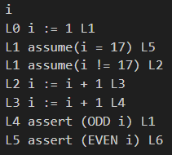
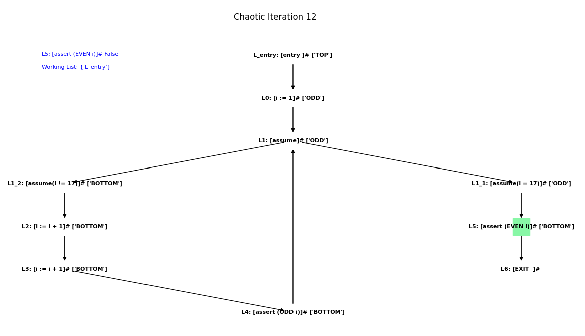
Test Programs – Parity 2
assertion_fails_intentionally – The loop would terminate with $i$ having odd value.

Slide 11
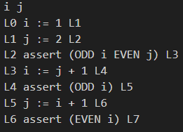
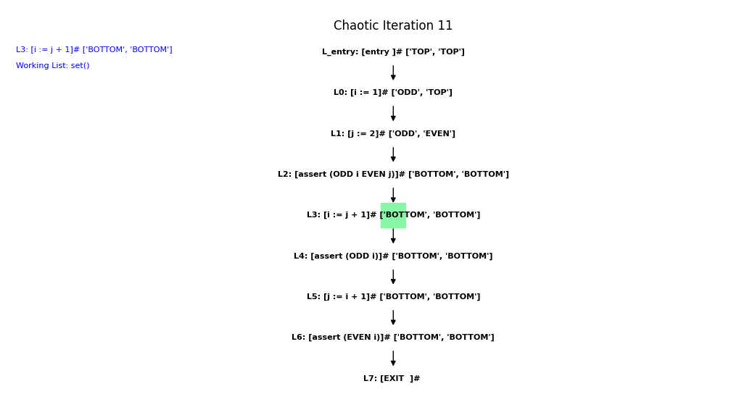
Test Programs – Parity 3
simple_test – Checking basic assertions in parity domain.

Slide 12
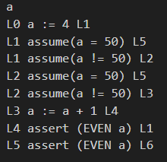
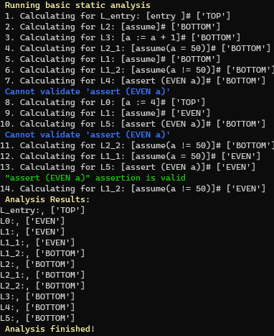
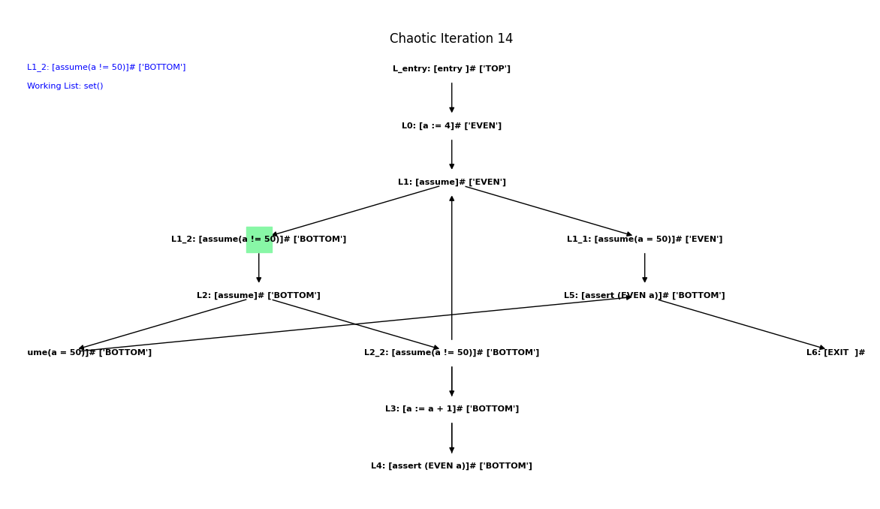
Test Programs – Parity 4
fast_double_loop – Regardless of how long it would take to run the double loop in the program, this program is validated in linear time! (regarding the number of rows in the program).

Slide 13
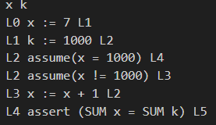
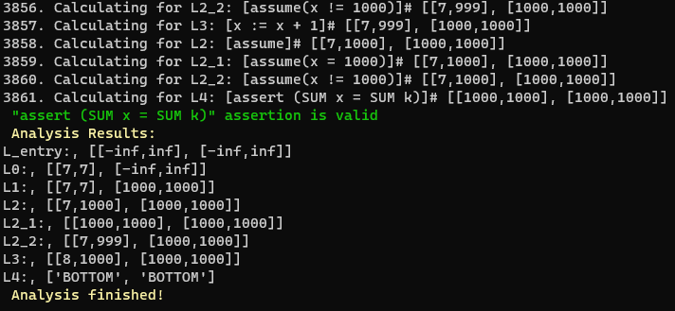
Test Programs – Summation 1
class_test – Running summation analysis without widening results in a long running time.

Slide 14
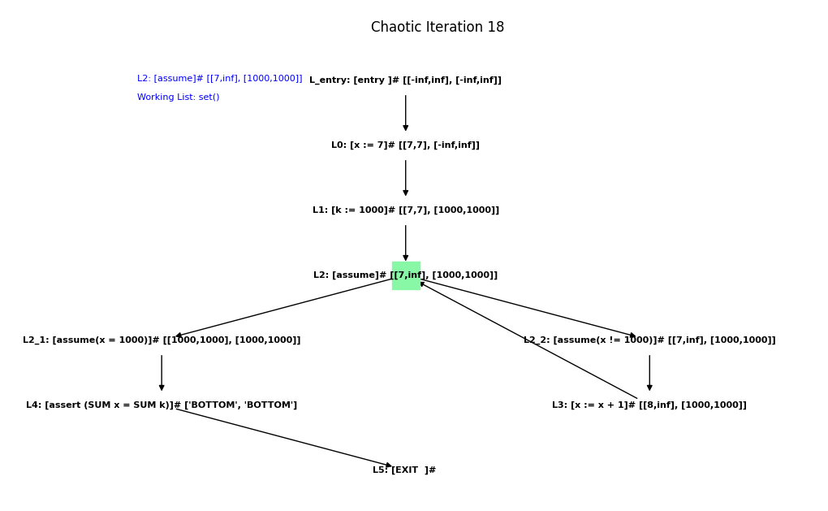
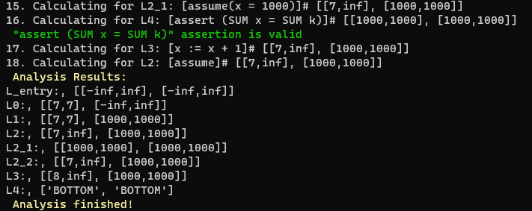
Test Programs – Summation 2
class_test – Running summation analysis with widening makes it much faster.

Slide 15
Test Programs – Summation 3
class_test – Running summation analysis with widening and narrowing for more accurate results.

Slide 16
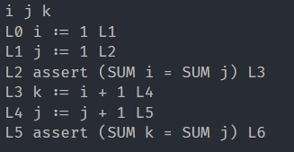
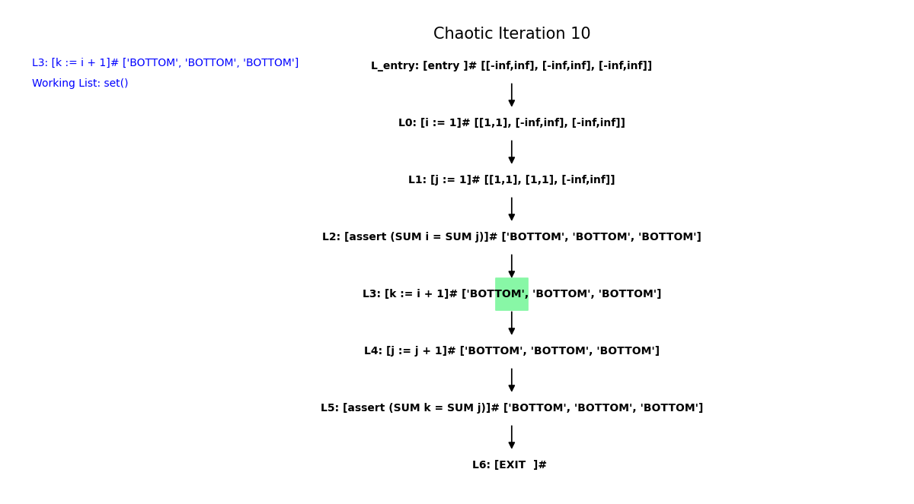
Test Programs – Summation 4
simple_test – Demonstrates basic assertions in the domain.

Slide 17
Test Programs – Combined Domain
I used all tests from previous domains.
In addition, I used two more tests, shown in the following slides.

Slide 18
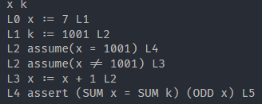
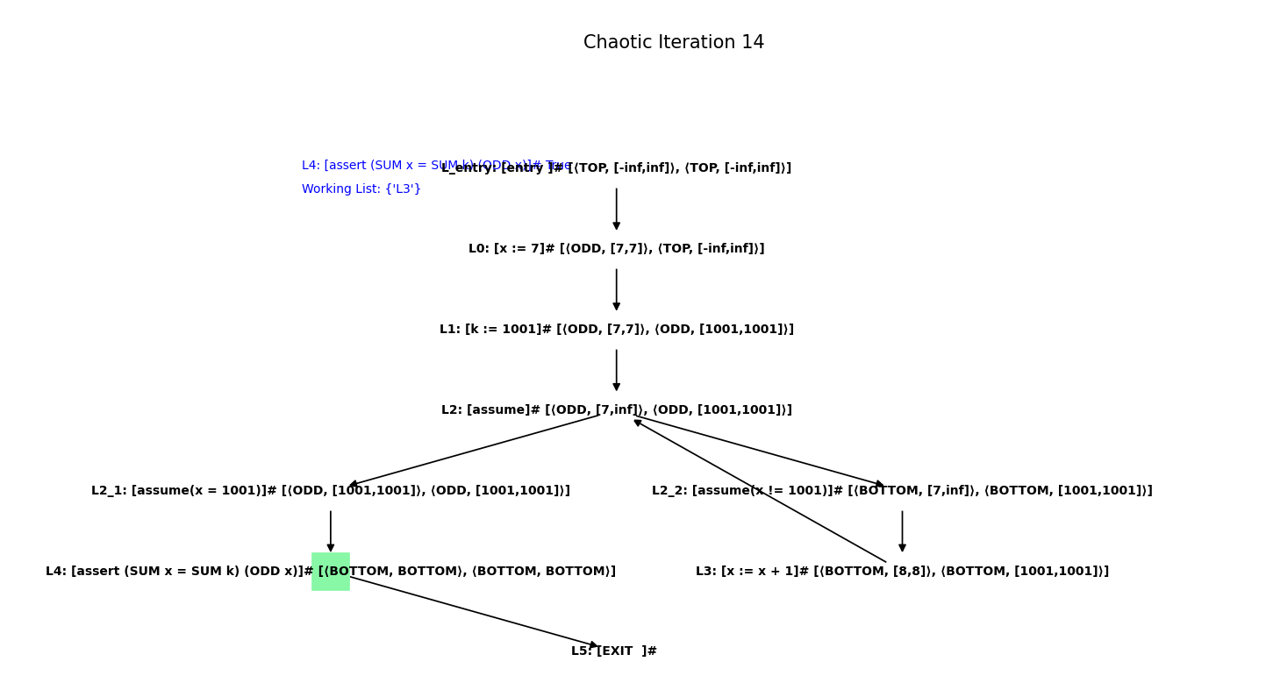
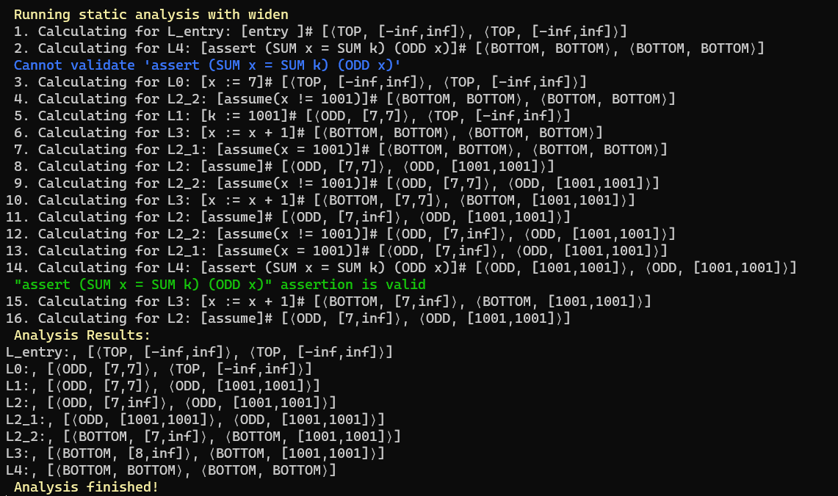
Test Programs – Combined Domain 1
successful_run –

Slide 19
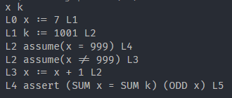
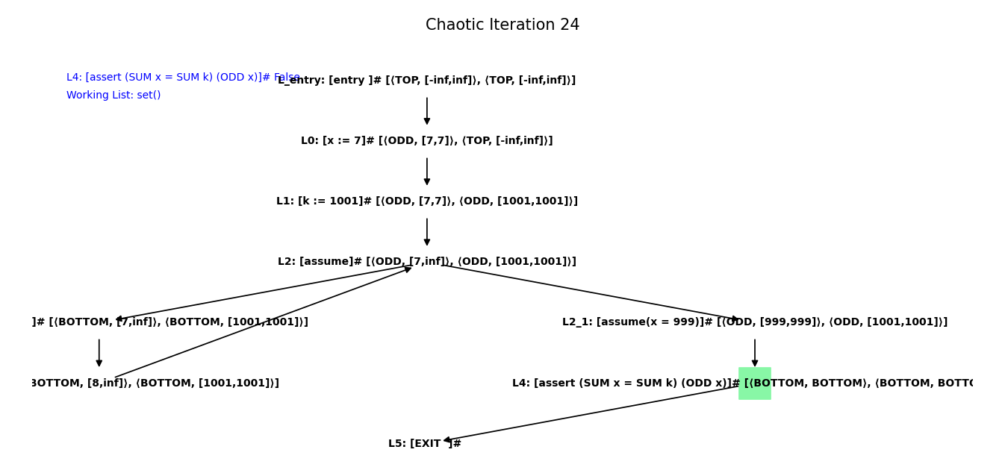
Test Programs – Combined Domain 2
summation_fails –

Slide 20
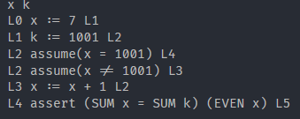
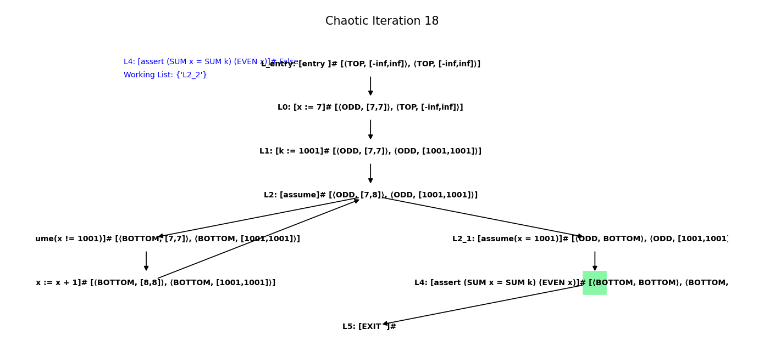
Test Programs – Combined Domain 3
parity_fails–

